Slide 1



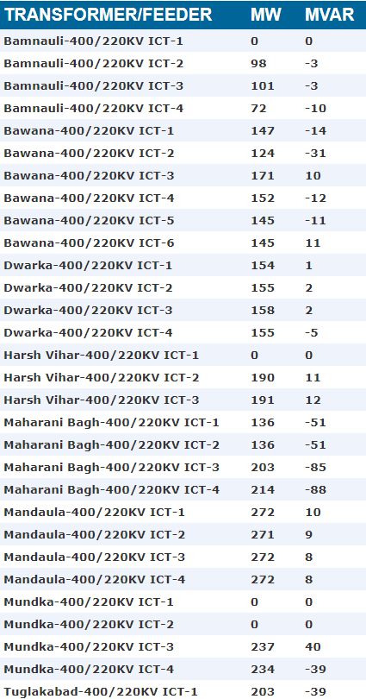

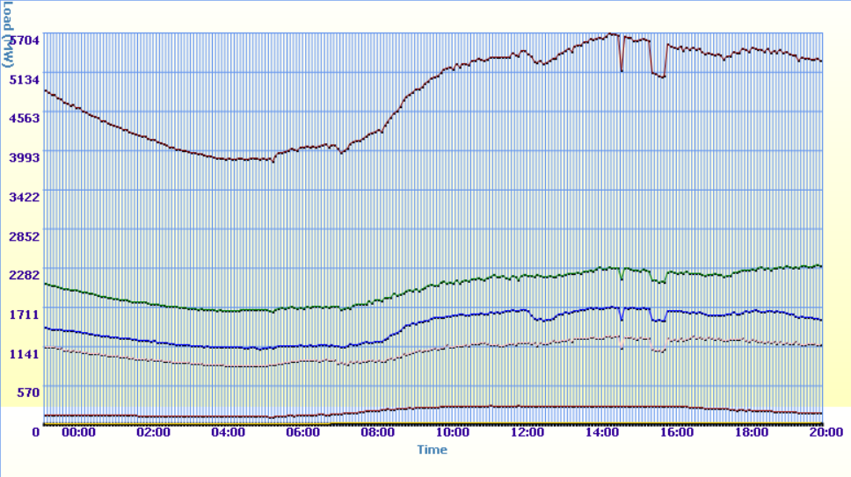
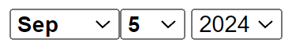






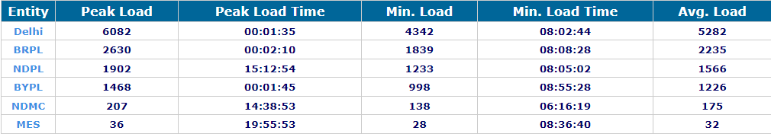

Tata Power Delhi Distribution Limited
HOME
Real Time Forecasting Graph (Load vs Time Series)
This graph depicts the real time load forecasting predicted by Power Shakti: The AI. It forecasting as per the daily trends
Load Curve For:
STATISTICS
Constituent:
Archives
CAUTIONS
2023
2022
2019
2021
2018
JANUARY
2017
FEBRUARY
MARCH
COMMUNITY
SUPPORT
APRIL
2016
MAY
JUNE
2015
JULY
AUGUST
2014
SEMPTEMBER
OCTOBER
2013
NOVEMBER
DECEMBER
2020
2012
SETTINGS
INFO

Slide 2
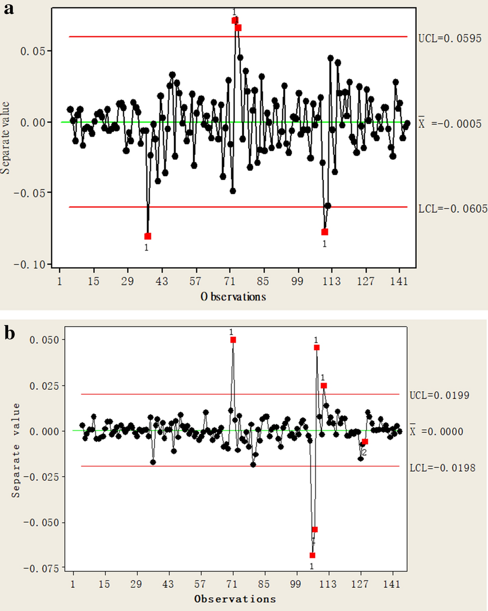

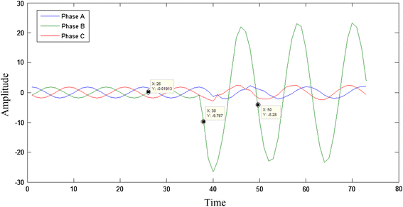

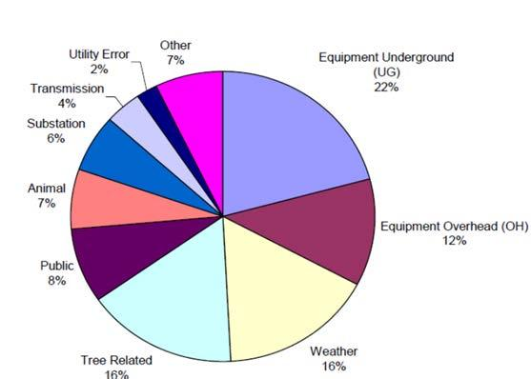
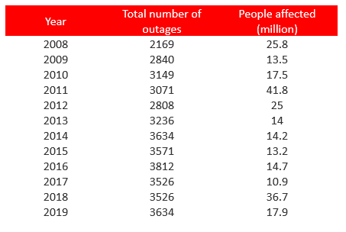
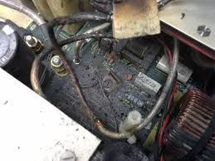
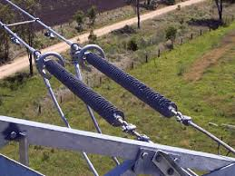
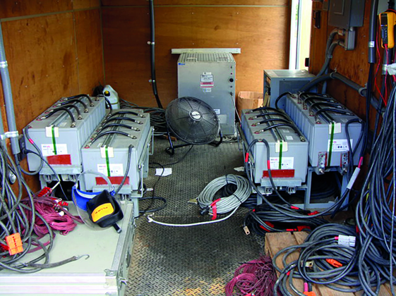
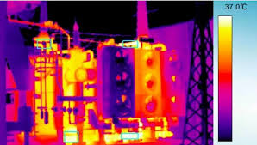
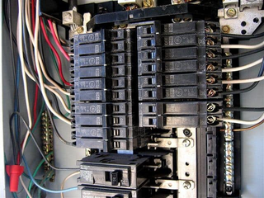
Tata Power Delhi Distribution Limited
HOME
Fault Forecasting For Transformers
Fault Forecasting of Hardware System
Predictive Maintenance
Circuit Breaker Trips
Feeder: Mundka- 400/330KV ICT-3
Issue: Working Capacity Decrease
Resoltion: Upcoming maintianence
Component: Circuit Breaker
Issue: Circuit breaker trips frequently, which could indicate underlying problems such as overcurrent, short circuits, or mechanical failure within the breaker itself.
STATISTICS
Learn More
Learn More
Oil Level Low
Busbar Faults
Feeder: Mundka- 400/330KV ICT-1
Issue: Oiling Level Low
Resoltion: Check the level of Oil with the external conditions near it
Component: Busbar
Issue: Busbar overheating or insulation failure, potentially caused by loose connections, high currents, or contamination.
CAUTIONS
Learn More
Learn More
Previous Outages & Fault Detections
Search for outages, faults
COMMUNITY
SUPPORT
Voltage Regulator Failure
02-06-2024
Regulator fails to maintain proper voltage levels.Voltage fluctuations can affect equipment performance and power quality.
Insulator Breakage
02-06-2024
Physical damage leading to electrical arcing or short circuits.Increased risk of power outages and potential safety hazards.
SETTINGS
Battery Bank Degradation
01-06-2024
Reduced capacity or failure to provide backup power.Loss of reliable backup power for critical systems during outages.
Transformer Overheating
01-06-2024
The transformer may experience reduced efficiency and potential damage, leading to system instability and higher risk of failure.
Circuit Breaker Trip
01-06-2024
INFO
Frequent tripping due to overcurrent or short circuits. Frequent interruptions can disrupt power supply and cause operational inefficiencies.

Slide 3

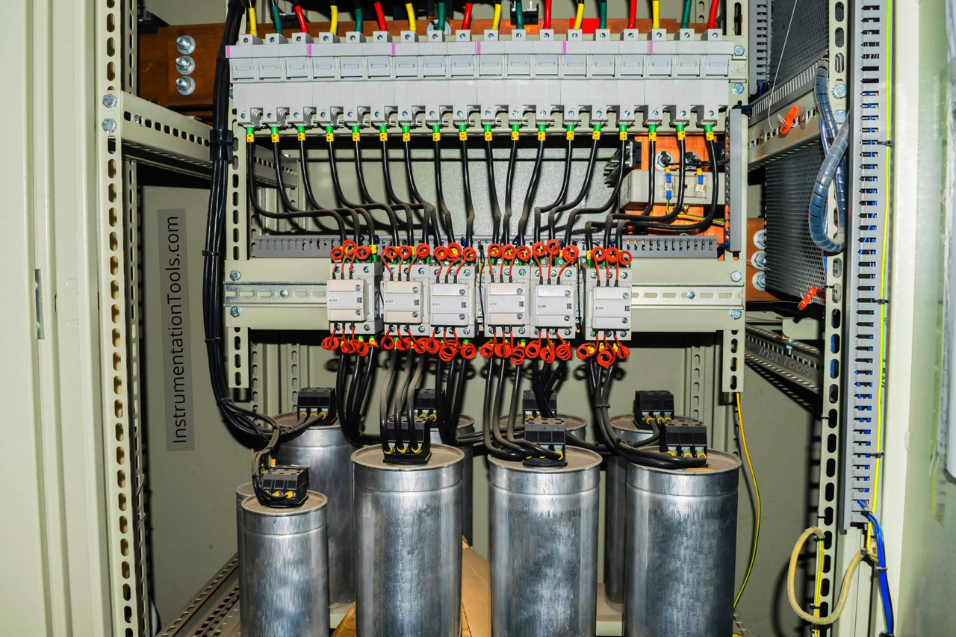
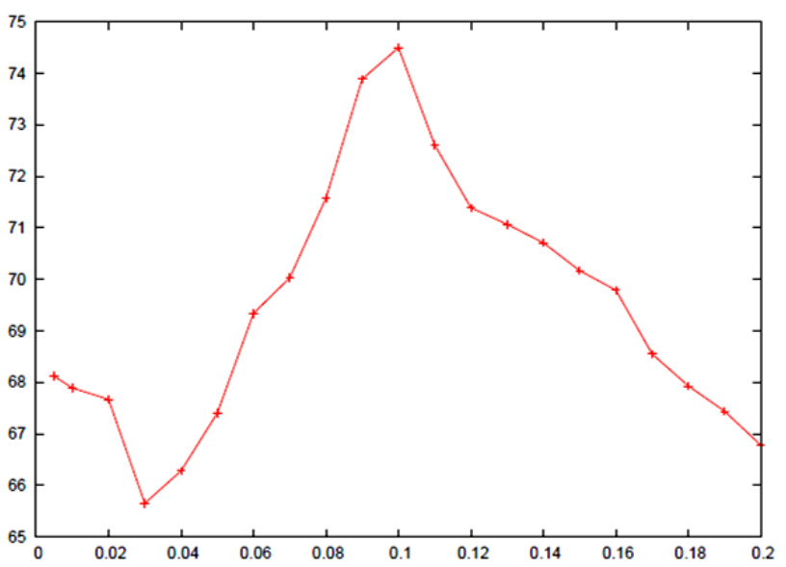
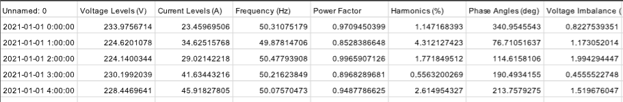
Tata Power Delhi Distribution Limited
HOME
Alert Mechanism Triggered Due to Capacitor Bank Issues
STATISTICS
Feeder: Mundka- 400/330KV ICT-3
Entity Issue: Capacitor Bank failing to correct the power factor properly can lead to inefficient energy use, increased utility bills, and potential overloading of other equipment.
Description: A utility substation's capacitor bank is designed to .
CAUTIONS
COMMUNITY
SUPPORT
improve power factor by compensating for reactive power in the system. Recently, the utility has observed that the capacitor bank is operating at higher temperatures than usual.
SETTINGS
INFO

Slide 4
Tata Power Delhi Distribution Limited
HOME
DISCOM TATA-DDL
Tell the oiling & the temperature levels of the transformer located in the Mundaka. Do they need maintainence now only?
STATISTICS
POWER SHAKTI
CAUTIONS
Transformer Report for Mundaka Site
Oiling Level:
Current Level: 75% (of maximum capacity)
Status: Within normal range
Temperature Levels:
Current Temperature: 85°C
Maximum Allowable Temperature: 95°C
Status: Normal, but approaching upper limit
Maintenance Status:
Immediate Maintenance Required: No
COMMUNITY
SUPPORT
SETTINGS
Search for any query
INFO

